Slide 1
PROJECT – PECUNIA (Banking System)

Slide 2
TEAM - F
Team Members –
Aditya
Ayush
Akshay
Aishwarya
Samanway

Slide 3
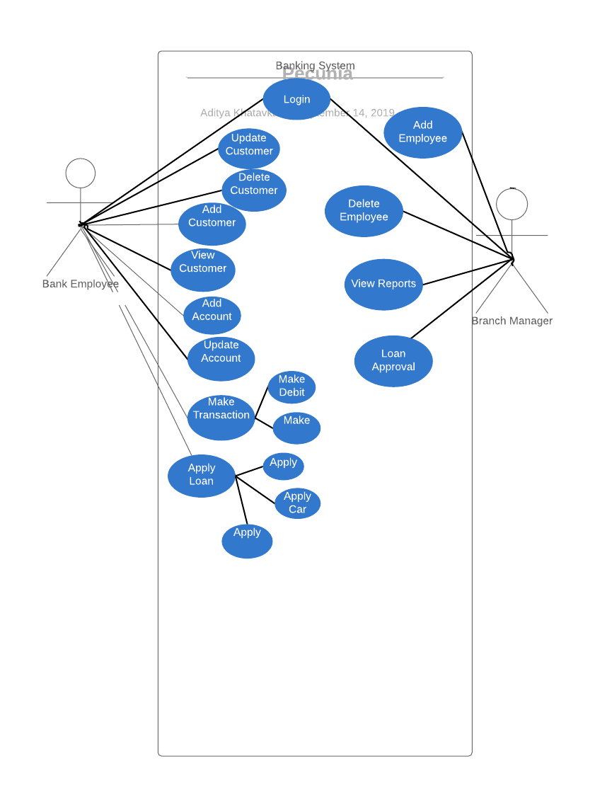
USE CASE DIAGRAM

Slide 4
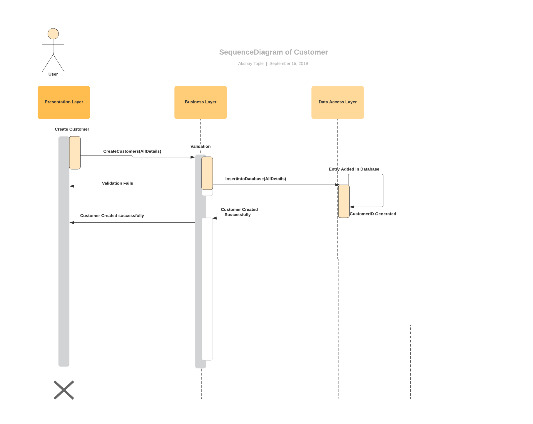

Slide 5
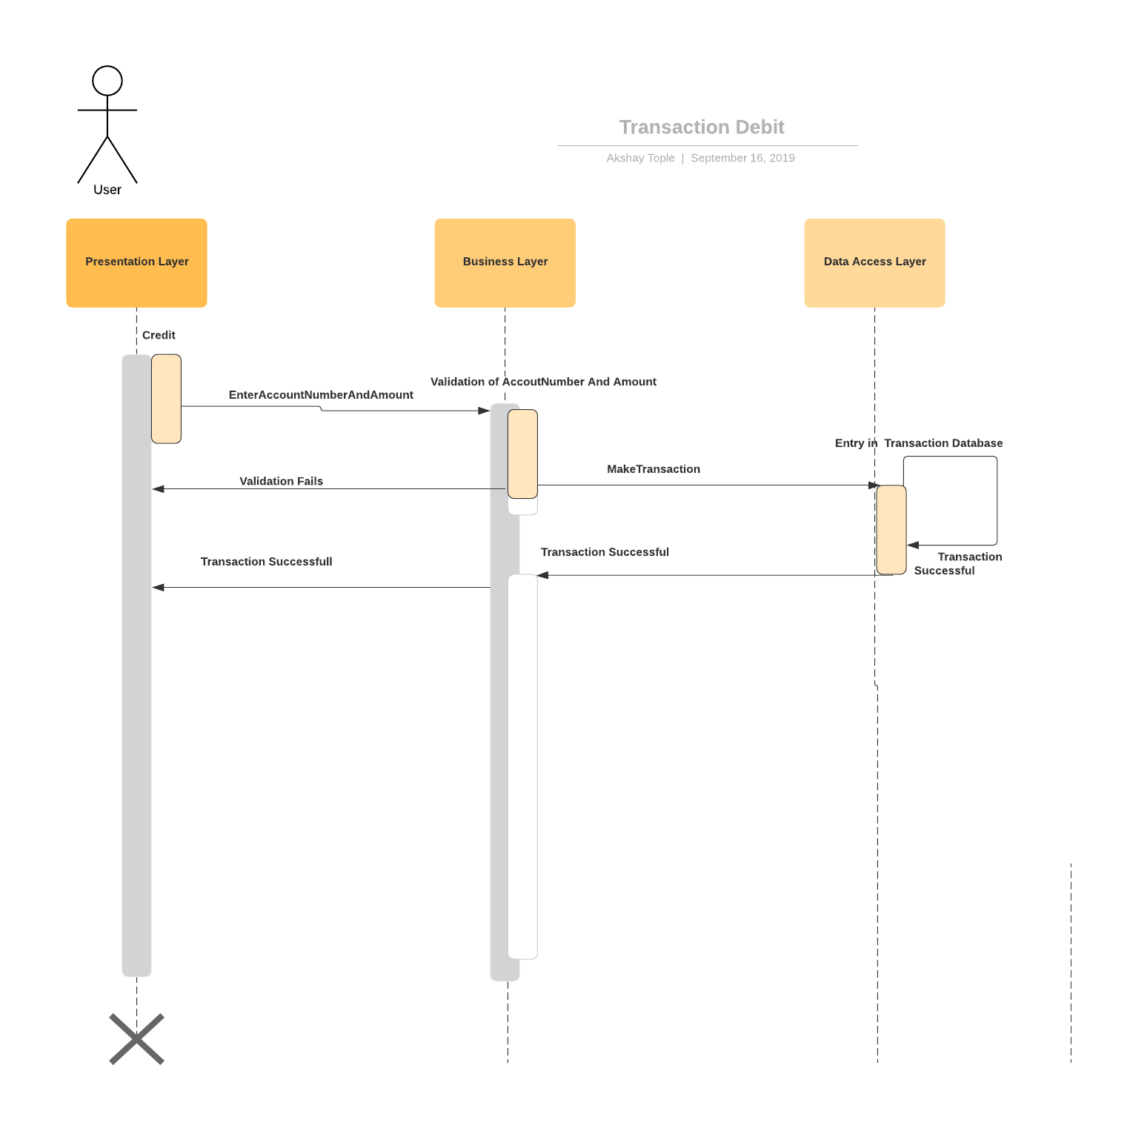

Slide 6


Slide 7
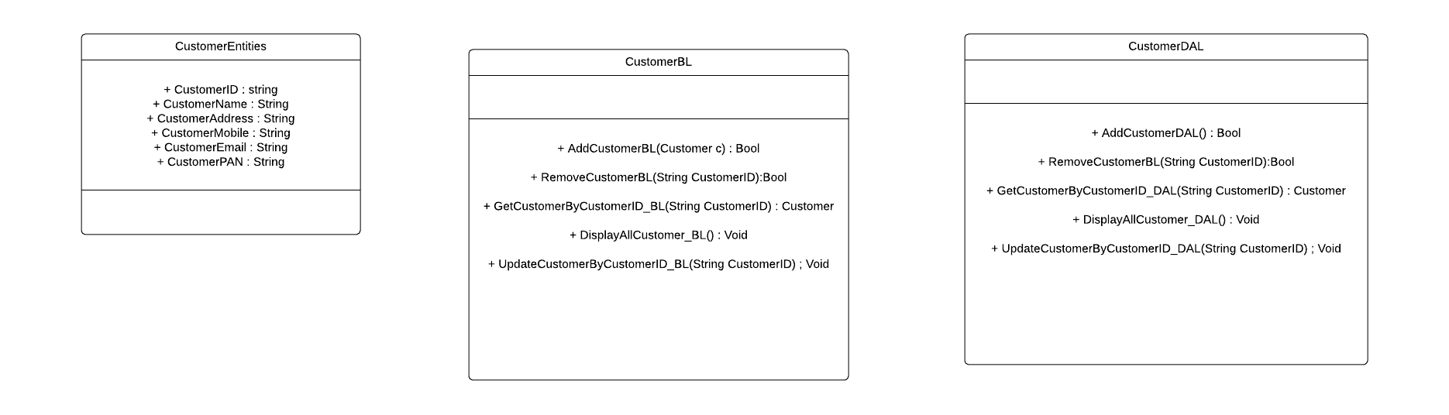
Class Diagram

Slide 8
THANK YOU

